Slide 1
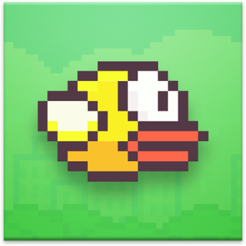
Flappy Bird
Think Visual - Concept
Preeti Maurya | MD Zaman | Rahul Garigipati

Slide 2

Exploring Visual Programming to create an interactive Flappy Bird game.
The game will require players/user to navigate the bird through obstacles using their voice pitch/gain.
We also plan to provide a navigation option via Keyboard key press additionally. We will implement a score sheet, where the user/player will be able to see their achieved score.
If the bird gets hit with an obstacle, then the game is over and need to restart.

Slide 3
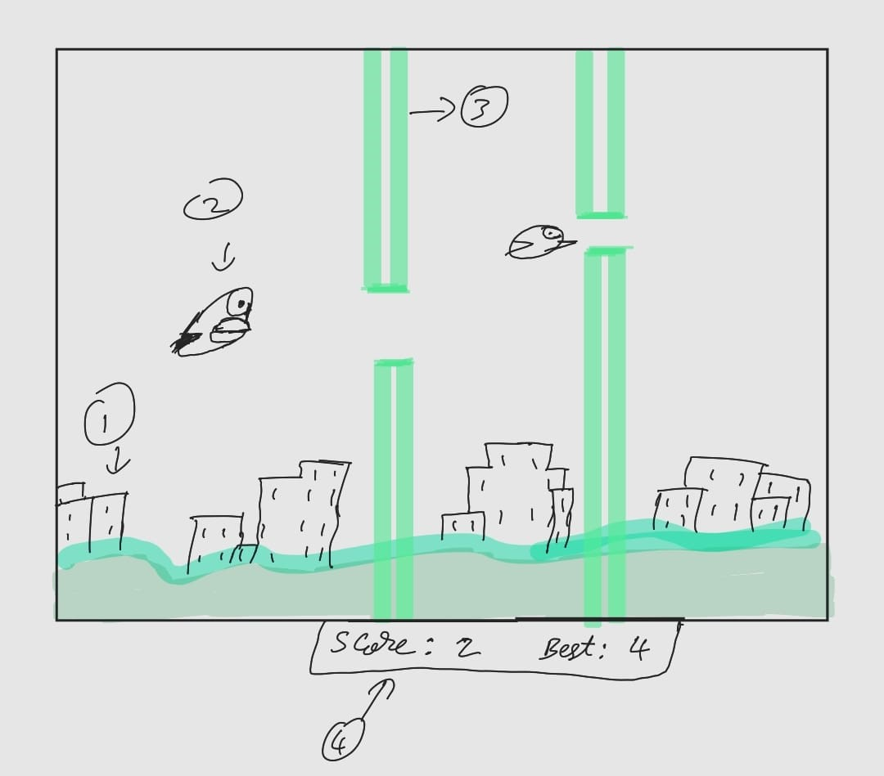
Concept
A rough sketch of how our game is going to be implemented.

Slide 4



Concept cont.
Game mechanics:
Background: A side scrolling background image to display the game's background.
Bird Sprite: A Sprite that represents the player-controlled bird.
Pipe Sprite: A Sprite that represents the pipes/obstacles that the bird must navigate through.
Score Counter: A counter that keeps track of the Players/Users score.
https://www.spriters-resource.com/mobile/flappybird/sheet/59894/

Slide 5

Concept contd.
Additional In-Game mechanics:
Ground Sprite: A Sprite that represents the ground where the bird is flying over.
Collision Detection: A function that detects when the bird collides with a pipe or the ground.
Gravity and Jump Mechanics: A system that stimulates the effects of gravity and allows the Players/Users to control the bird upwards movement by using their Voice Pitch/Gain or tapping a key.
Audio Input: Audio Input for when the audio is given by the user/player pitch/gain to move the bird.

Slide 6
Technology
Hardware:
Personal Computers or Laptops with Max version 8 installed and setup.
A Microphone/In-built microphone.
A Keyboard.
Software:
We will be using the Visual Programming Language Max Version 8.
We will be using the libraries like Jitter and OpenGL.
We will also be implementing different Jitter Objects depending on the use cases.

Slide 7
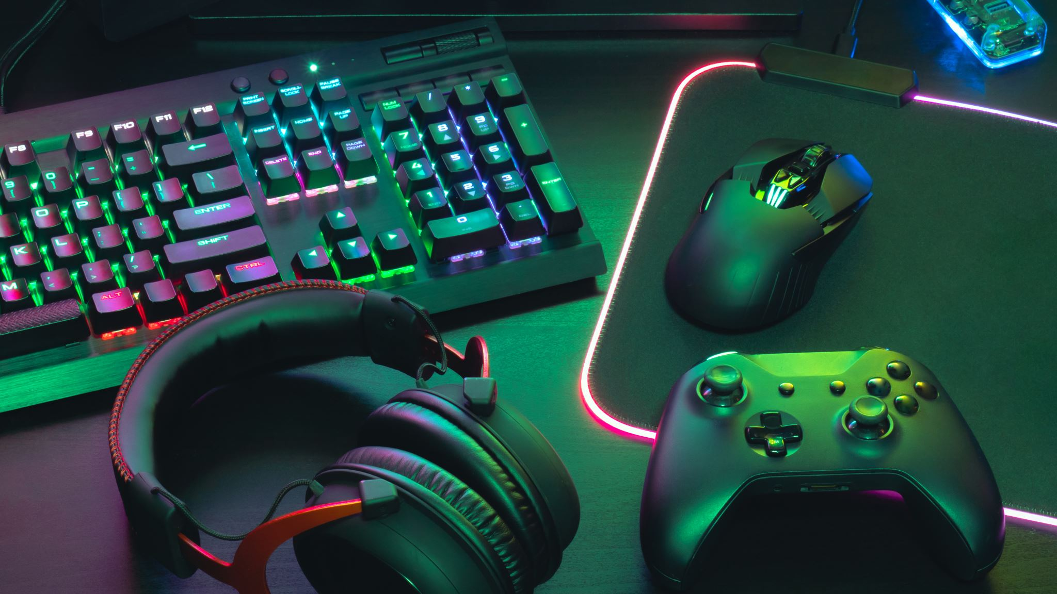
Background
Research on common approaches [1] for voice-controlled game design, concludes that the recent designs are overly concerned with speech/word recognition.
[2] depicts an anticipatory error handling using voice-controlled game where the game would perform in a locally optimized action in respect to goal completion and obstacle avoidance, when a command is not recognized.
[3] depicts the evaluation of different control schemes in a 2D game for better understanding of the user experience of the control schemes.

Slide 8
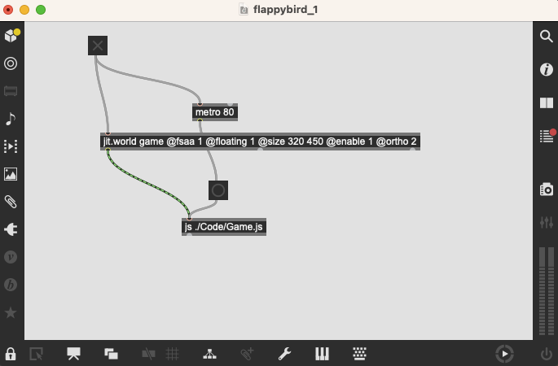
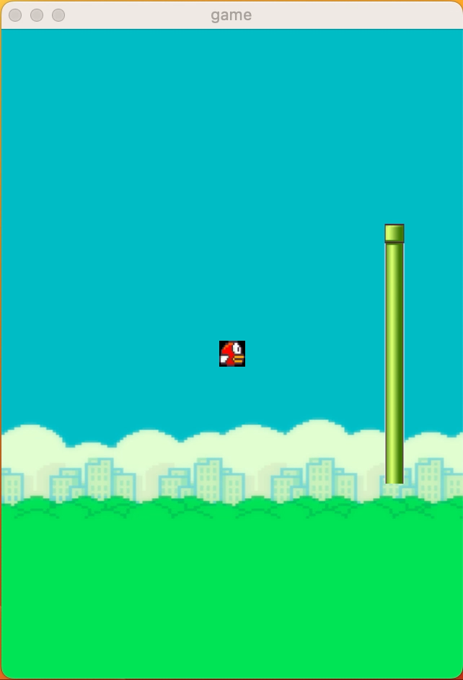
Demo

Slide 9
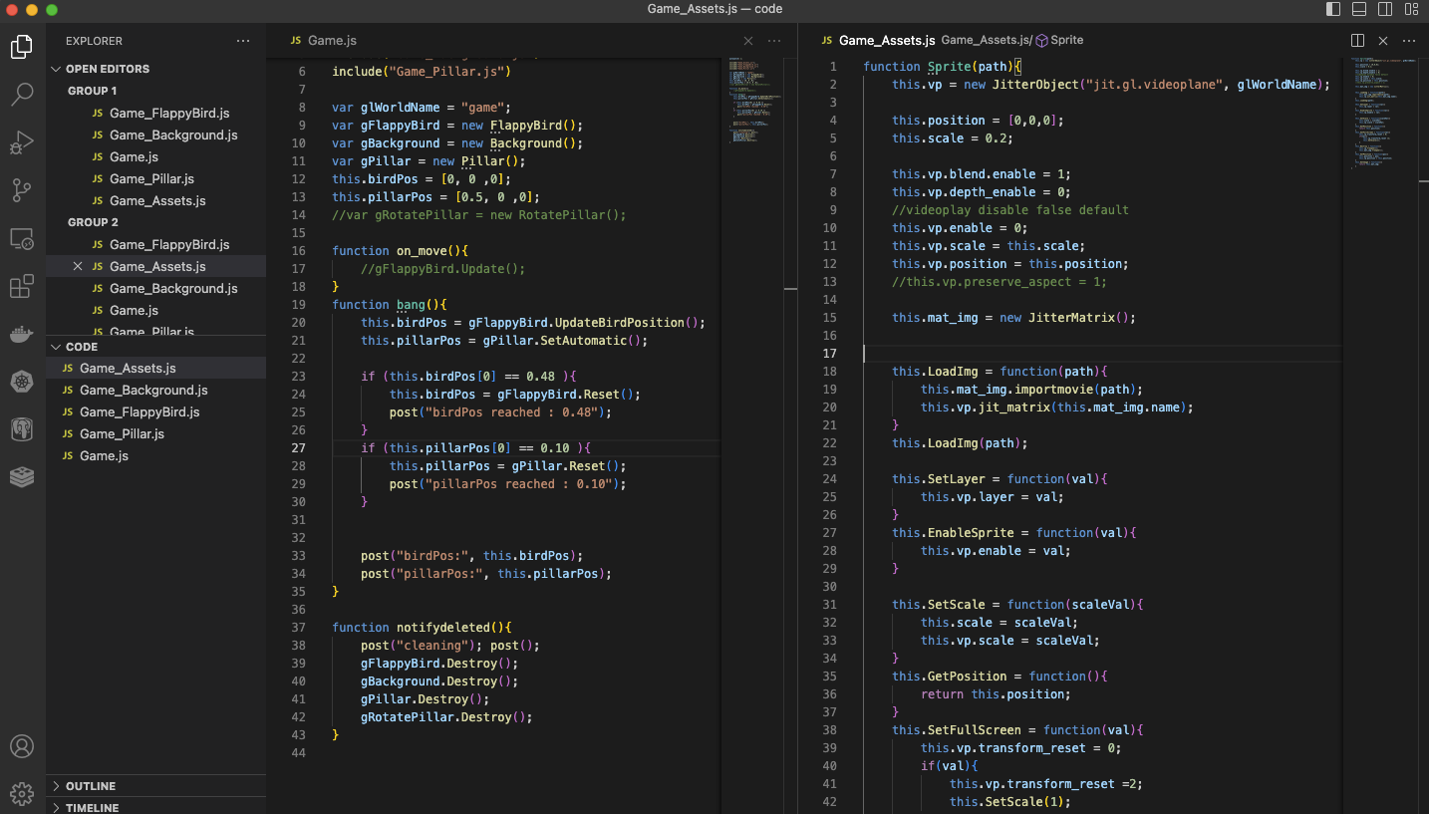
Demo

Slide 10

Outline
Our Research has provided us with the insights on the current strategies and challenges in digital game-design.
Our project`s aim and focus is to make/showcase the utilization of visual programming in game development.
There are different dedicated tools available to design games eg. Unity, Max2D.
We want to explore the Jitter OpenGL library in Max 8 to develop a game.

Slide 11
Future Scope
To implement distributed multiplayer game design of voice controlled flappy bird.
It will help us in getting more insights on the effectiveness/accuracy of voice interaction in side-scrolling competitive games.

Slide 12
References
Fraser Allison, Marcus Carter, Martin Gibbs, and Wally Smith. Design patterns for voice interaction in games. In Proceedings of the 2018 Annual Symposium on Computer-Human Interaction in Play, pages 5–17, 2018.
Nima Zargham, Johannes Pfau, Tobias Schnackenberg, and Rainer Malaka. “i didn’t catch that, but i’ll try my best”: Anticipatory error handling in a voice controlled game. In Proceedings of the 2022 CHI Conference on Human Factors in Computing Systems, pages 1–13, 2022.
Fernando Rocha, Pedro Machado Santa, Jorge CS Cardoso, Lu ́ıs Lucas Pereira, and Lic ́ınio Roque. Mapping controls on a 2d user drawn racetracks driving game-an usability assess- ment. In Extended Abstracts of the Annual Symposium on Computer-Human Interaction in Play Companion Extended Abstracts, pages 653–660, 2019.

Slide 13

Thank You

